Slide 1

CLOUD COMPUTING

Slide 2
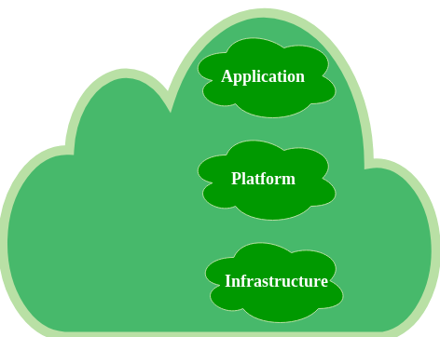
What is Cloud Computing?
Cloud computing means storing and accessing the data and programs on remote servers that are hosted on the internet instead of the computer’s hard drive or local server. Cloud computing is also referred to as Internet-based computing.
Cloud Computing Architecture: Cloud computing architecture refers to the components and sub-components required for cloud computing. These components typically refer to:
Front end(fat client, thin client)
Back-end platforms(servers, storage)
Cloud-based delivery and a network(Internet, Intranet, Intercloud).

Slide 3
Now, let’s have a look at hosting:
Let’s say you have a company and a website and the website has a lot of communications that are exchanged between members.
You start with a few members talking with each other and then gradually the number of members increases.
As the time passes, as the number of members increases, there would be more traffic on the network and your server will get slow down.
This would cause a problem. A few years ago, the websites are put on the server somewhere, in this way you have to run around or buy and set the number of servers. It costs a lot of money and takes a lot of time.
You pay for these servers when you are using them and as well as when you are not using them. This is called hosting.
This problem is overcome by cloud hosting. With Cloud Computing, you have access to computing power when you needed. Now, your website is put in the cloud server as you put it on a dedicated server. People start visiting your website and if you suddenly need more computing power, you would scale up according to the need.

Slide 4
Cloud Deployment Model
What is a Cloud Deployment Model?
Cloud Deployment Model functions as a virtual computing environment with a deployment architecture that varies depending on the amount of data you want to store and who has access to the infrastructure.
Types of Cloud Computing Deployment Models
The cloud deployment model identifies the specific type of cloud environment based on ownership, scale, and access, as well as the cloud’s nature and purpose.
The location of the servers you’re utilizing and who controls them are defined by a cloud deployment model.
It specifies how your cloud infrastructure will look, what you can change, and whether you will be given services or will have to create everything yourself.
Relationships between the infrastructure and your users are also defined by cloud deployment types.

Slide 5
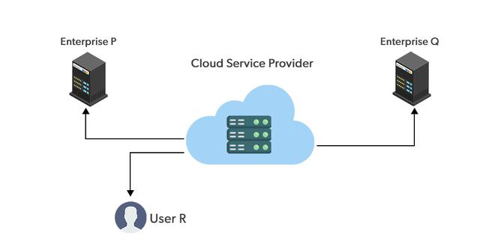
Public Cloud
The public cloud makes it possible for anybody to access systems and services.
The public cloud may be less secure as it is open to everyone.
The public cloud is one in which cloud infrastructure services are provided over the internet to the general people or major industry groups.
The infrastructure in this cloud model is owned by the entity that delivers the cloud services, not by the consumer.
It is a type of cloud hosting that allows customers and users to easily access systems and services.
This form of cloud computing is an excellent example of cloud hosting, in which service providers supply services to a variety of customers.
In this arrangement, storage backup and retrieval services are given for free, as a subscription, or on a per-user basis. For example, Google App Engine, etc.

Slide 6

Realtime use case of Public Cloud
Netflix is by far the best case study for the public cloud.
Before 2008, Netflix used relational databases in its data centres.
Storing customer details, preferences, and thousands of video content, the company eventually faced a significant issue in the database in 2008.
With the growing business needs, customer base, and data storage, Netflix had to rethink the data centre situation.
Being the genius it is, Netflix saw the potential in cloud computing way before cloud was on the scene.
Netflix migrated its functioning, content, and delivery network to Amazon’s public cloud — AWS.
What is interesting is that Amazon has its video-streaming service.
Amazon’s cloud has benefitted the streaming service provider by supporting the high-speed growth in the global market.
It has almost 25 times as many streaming members as it had in 2008.
It is very rare to see downtime errors on Netflix.

Slide 7
Pros of the Public Cloud Model
Minimal Investment: Because it is a pay-per-use service, there is no substantial upfront fee, making it excellent for enterprises that require immediate access to resources.
No setup cost: The entire infrastructure is fully subsidized by the cloud service providers, thus there is no need to set up any hardware.
Infrastructure Management is not required: Using the public cloud does not necessitate infrastructure management.
No maintenance: The maintenance work is done by the service provider (not users).
Dynamic Scalability: To fulfil your company’s needs, on-demand resources are accessible.

Slide 8
Cons of the Public Cloud Model
Less secure: Public cloud is less secure as resources are public so there is no guarantee of high-level security.
Low customization: It is accessed by many public so it can’t be customized according to personal requirements.

Slide 9
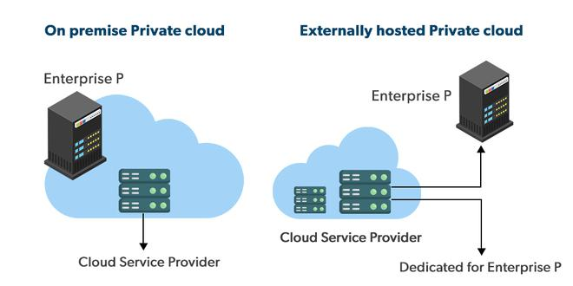
Private Cloud
The private cloud deployment model is the exact opposite of the public cloud deployment model.
It’s a one-on-one environment for a single user (customer).
There is no need to share your hardware with anyone else.
The distinction between private and public clouds is how you handle all the hardware.
It is also called the “internal cloud” & it refers to the ability to access systems and services within a given border or organization.
The cloud platform is implemented in a cloud-based secure environment that is protected by powerful firewalls and under the supervision of an organization’s IT department.
The private cloud gives greater flexibility of control over cloud resources.

Slide 10
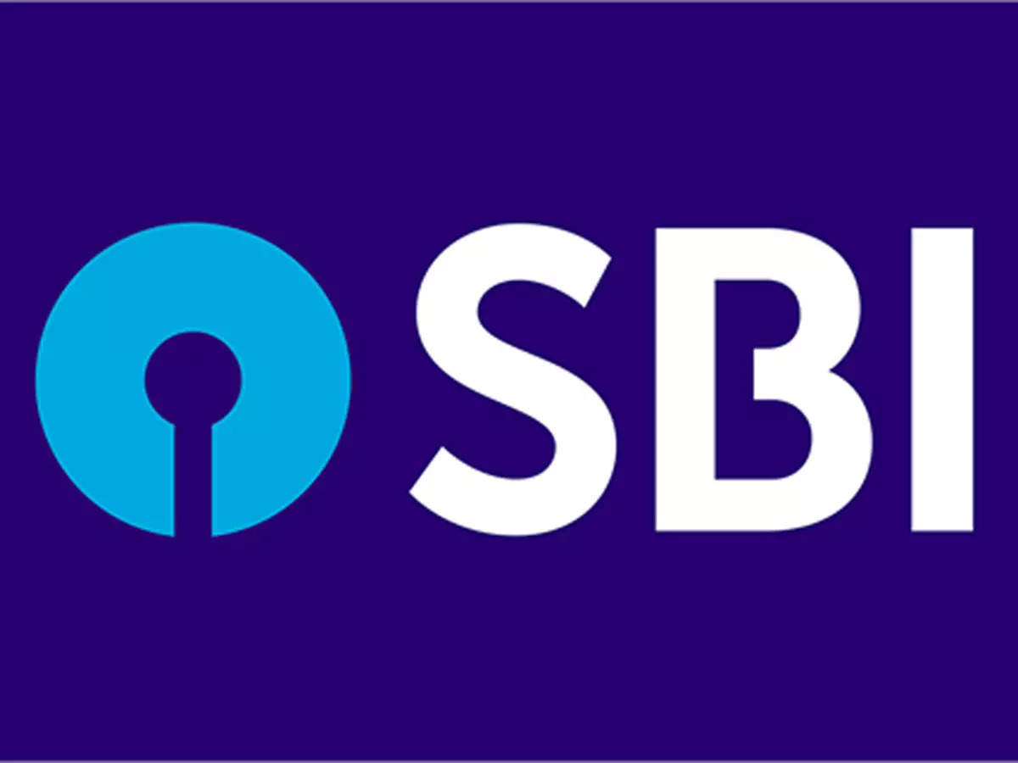
Realtime use case of Private Cloud
To stay ahead of several competitors, the State Bank of India (SBI) had to up its game to establish relevance with the digitally aware youth.
Faster, reliable, and secured payments were the demands of the primary consumer market.
User growth and the rise of digital modes of payments called for an unparalleled level of change for SBI.
The group opted to take the plunge into IT transformation.
SBI uses one of India’s most robust private clouds — “MeghDoot,” of about 7500 VMs hosting several financial services applications based on various technologies.
Banking applications and services are provided with high availability and scalability.

Slide 11
Pros of the Private Cloud Model
Better Control: You are the sole owner of the property. You gain complete command over service integration, IT operations, policies, and user behaviour.
Data Security and Privacy: It’s suitable for storing corporate information to which only authorized staff have access. By segmenting resources within the same infrastructure, improved access and security can be achieved.
Supports Legacy Systems: This approach is designed to work with legacy systems that are unable to access the public cloud.
Customization: Unlike a public cloud deployment, a private cloud allows a company to tailor its solution to meet its specific needs.

Slide 12
Cons of the Private Cloud Model
Less scalable: Private clouds are scaled within a certain range as there is less number of clients.
Costly: Private clouds are more costly as they provide personalized facilities.

Slide 13
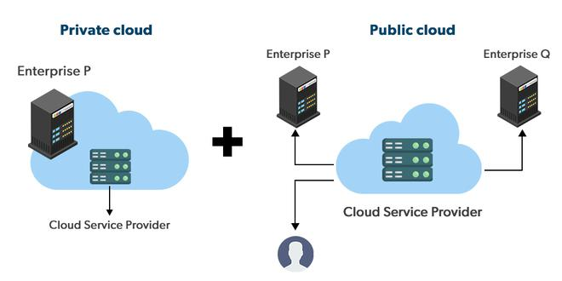
Hybrid Cloud
By bridging the public and private worlds with a layer of proprietary software, hybrid cloud computing gives the best of both worlds.
With a hybrid solution, you may host the app in a safe environment while taking advantage of the public cloud’s cost savings.
Organizations can move data and applications between different clouds using a combination of two or more cloud deployment methods, depending on their needs.

Slide 14

Realtime use case of Hybrid Cloud
BBC has recently signed a 5-year hybrid cloud contract with Object Matrix after the success of the Planet series.
It has been a customer of Object Matrix since 2010 with a Matrix Store on-premise 200TB.
After the recent shift of its headquarters, BBC has seen a spike in production.
Matrix Store ensures BBC gets the exact mix of On-premise and public cloud.
This called for the up-gradation of its existing On-premise data storage facilities.
Also, with the current situation of working from anywhere, it needed to ensure that the external team members could access the content effectively.
The upgrade to its existing Matrix Store infrastructure will facilitate the company to protect added content of several on-premise works- functionalities.
Well, cloud deployment models do not stop here.
Multi-cloud and community clouds are also considered a part now this.

Slide 15
Pros of the Hybrid Cloud Model
Cost Effective: It is cost-effective because the cloud is shared by multiple organizations or communities.
Security: Community cloud provides better security.
Shared resources: It allows you to share resources, infrastructure, etc. with multiple organizations.
Collaboration and data sharing: It is suitable for both collaboration and data sharing.

Slide 16
Cons of the Hybrid Cloud Model
Limited Scalability: Community cloud is relatively less scalable as many organizations share the same resources according to their collaborative interests.
Rigid in customization: As the data and resources are shared among different organizations according to their mutual interests if an organization wants some changes according to their needs they cannot do so because it will have an impact on other organizations.

Slide 17
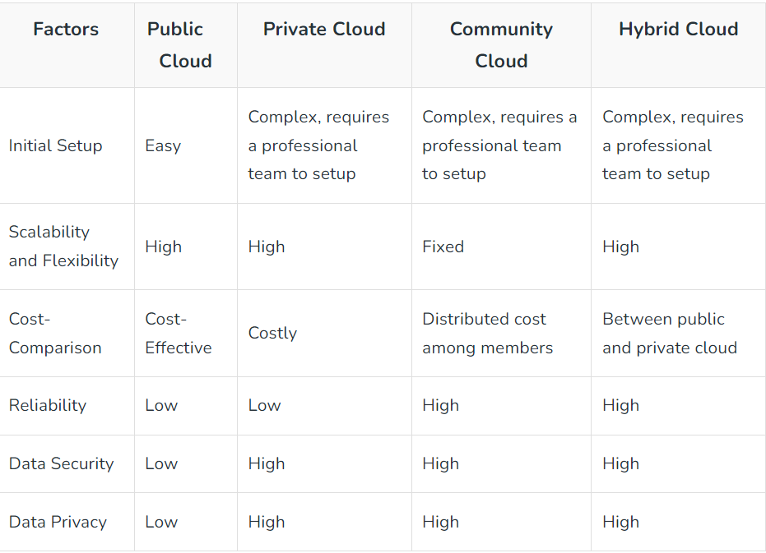
Overall Analysis of Cloud Deployment Models

Slide 18
Business Scenarios
Scenario #1:
A small business with 25–30 employees has decided to move its data and working functionalities onto the cloud. They are looking for highly accessible data, easy data backup, and cost-efficient. They also need accounting software and customer service tools. Which deployment model is best suited for the considered business?
Resolution: A public cloud system is great for organizations that want more elasticity, cost-effectiveness, and the latest technology.

Slide 19
Business Scenarios(Continues…)
Scenario #2:
A national bank requires high security, privacy, and reliability cloud deployment services, allowing only authorized persons to access resources. Which deployment model is best suited for these requirements?
Resolution: A private cloud system is flexible, secured, and has high scalability, which allows organizations to customize their infrastructures per their necessities Scenario

Slide 20
Business Scenarios(Continues…)
Scenario #3:
A retail company has websites that require high performance. They have on-premise servers to handle the work, but sometimes during seasons of sales, they experience periods of spikes in traffic. Which deployment model will handle their traffic spikes and provide the on-premise model?
Resolution: Hybrid cloud efficiently handles the on-premise model during the off-season and allows users to offload overage traffic when their on-premise systems are overloaded.

Slide 21
Business Scenarios(Continues…)
Scenario #4:
A global company has decided to offer video streaming solutions for business to share their ideas and presentations and pitch them to clients. They wish to adopt cloud scaling to enable larger bandwidth and speed. Which deployment model is best suited for the considered global company?
Resolution: Public cloud allows streaming platforms to increase their bandwidth to provide better video streaming performance and viewing experience.

Slide 22
Business Scenarios(Continues…)
Scenario #5:
An organization wants to build infrastructure designed for users to access book members through electronic devices. The borrowed books can be verified using the cloud by sharing resources between devices. Which deployment model will help them build such a system?
Resolution: Private cloud can come to a rescue when an organization wants to share resources only with its members

Slide 23
Service Model
Cloud Computing can be defined as the practice of using a network of remote servers hosted on the Internet to store, manage, and process data, rather than a local server or a personal computer.
Companies offering such kinds of cloud computing services are called cloud providers and typically charge for cloud computing services based on usage.
Types of Cloud Computing
Most cloud computing services fall into five broad categories:
Software as a service (SaaS)
Platform as a service (PaaS)
Infrastructure as a service (IaaS)
Anything/Everything as a service (XaaS)
Function as a Service (FaaS)

Slide 24
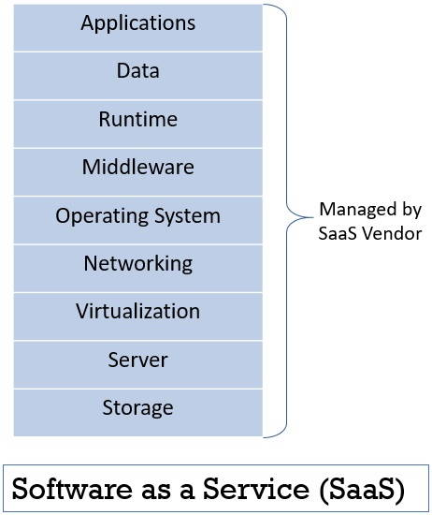
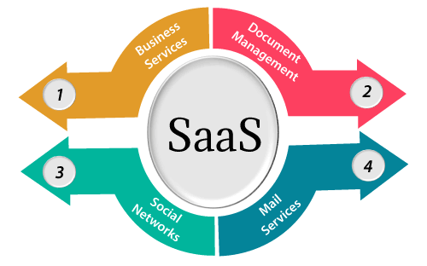
Software as a Service
SaaS is also known as "On-Demand Software". It is a software distribution model in which services are hosted by a cloud service provider. These services are available to end-users over the internet so, the end-users do not need to install any software on their devices to access these services.
There are the following services provided by SaaS providers -
Business Services - SaaS Provider provides various business services to start-up the business. The SaaS business services include ERP (Enterprise Resource Planning), CRM (Customer Relationship Management), billing, and sales.
Document Management - SaaS document management is a software application offered by a third party (SaaS providers) to create, manage, and track electronic documents.
Example: Slack, Samepage, Box, and Zoho Forms.
Social Networks - As we all know, social networking sites are used by the general public, so social networking service providers use SaaS for their convenience and handle the general public's information.
Mail Services - To handle the unpredictable number of users and load on e-mail services, many e-mail providers offering their services using SaaS.

Slide 25
Advantages of SaaS cloud computing layer
SaaS is easy to buy
SaaS pricing is based on a monthly fee or annual fee subscription, so it allows organizations to access business functionality at a low cost, which is less than licensed applications.
Unlike traditional software, which is sold as a licensed based with an up-front cost (and often an optional ongoing support fee), SaaS providers are generally pricing the applications using a subscription fee, most commonly a monthly or annual fee.
One to Many
SaaS services are offered as a one-to-many model means a single instance of the application is shared by multiple users.
Less hardware required for SaaS
The software is hosted remotely, so organizations do not need to invest in additional hardware.
Low maintenance required for SaaS
Software as a service removes the need for installation, set-up, and daily maintenance for organizations. The initial set-up cost for SaaS is typically less than the enterprise software. SaaS vendors are pricing their applications based on some usage parameters, such as the number of users using the application. So SaaS does easy to monitor and automatic updates.
No special software or hardware versions are required
All users will have the same version of the software and typically access it through the web browser. SaaS reduces IT support costs by outsourcing hardware and software maintenance and support to the IaaS provider.
Multidevice support
SaaS services can be accessed from any device such as desktops, laptops, tablets, phones, and thin clients.
API Integration
SaaS services easily integrate with other software or services through standard APIs.

Slide 26
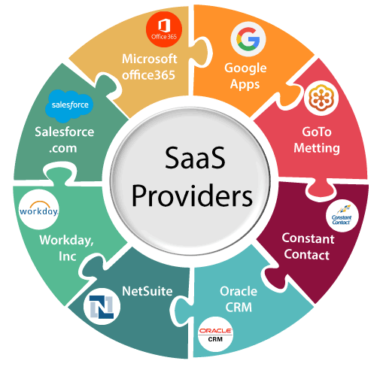
Disadvantages of SaaS cloud computing layer
Security
Actually, data is stored in the cloud, so security may be an issue for some users. However, cloud computing is not more secure than in-house deployment.
Latency issue
Since data and applications are stored in the cloud at a variable distance from the end-user, there is a possibility that there may be greater latency when interacting with the application compared to local deployment. Therefore, the SaaS model is not suitable for applications whose demand response time is in milliseconds.
Total Dependency on the Internet
Without an internet connection, most SaaS applications are not usable.
Switching between SaaS vendors is difficult
Switching SaaS vendors involves the difficult and slow task of transferring very large data files over the internet and then converting and importing them into another SaaS also.

Slide 27
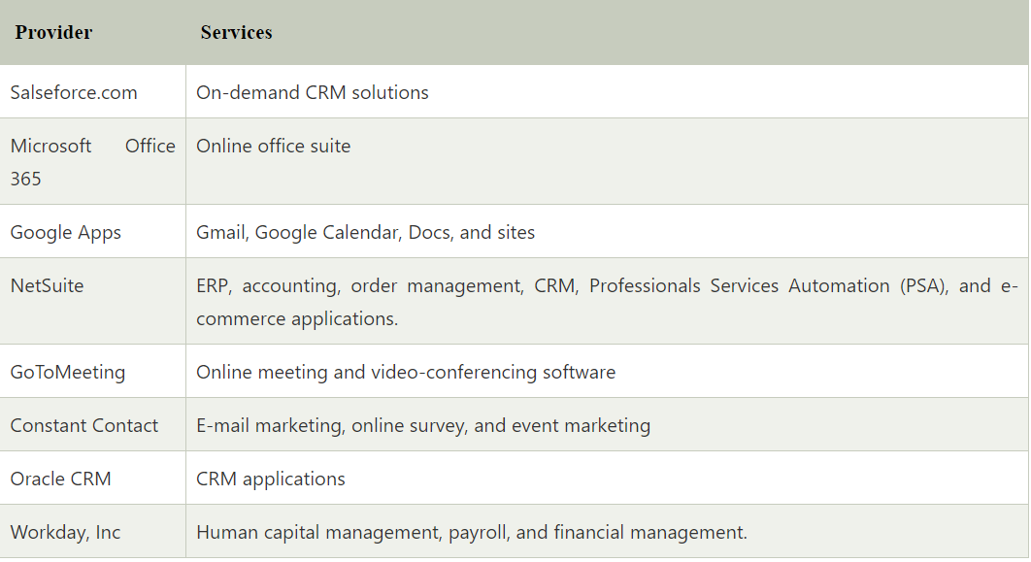
Popular SaaS Provider

Slide 28
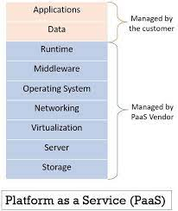
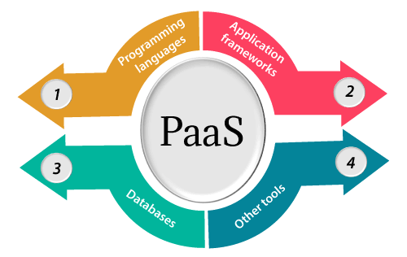
Platform as a Service
Platform as a Service (PaaS) provides a runtime environment. It allows programmers to easily create, test, run, and deploy web applications. You can purchase these applications from a cloud service provider on a pay-as-per use basis and access them using the Internet connection. In PaaS, back end scalability is managed by the cloud service provider, so end- users do not need to worry about managing the infrastructure.
PaaS includes infrastructure (servers, storage, and networking) and platform (middleware, development tools, database management systems, business intelligence, and more) to support the web application life cycle.
Example: Google App Engine, Force.com, Joyent, Azure.

Slide 29
Platform as a Service(Continues)
Programming languages
PaaS providers provide various programming languages for the developers to develop the applications. Some popular programming languages provided by PaaS providers are Java, PHP, Ruby, Perl, and Go.
Application frameworks
PaaS providers provide application frameworks to easily understand the application development. Some popular application frameworks provided by PaaS providers are Node.js, Drupal, Joomla, WordPress, Spring, Play, Rack, and Zend.
Databases
PaaS providers provide various databases such as ClearDB, PostgreSQL, MongoDB, and Redis to communicate with the applications.
Other tools
PaaS providers provide various other tools that are required to develop, test, and deploy the applications.

Slide 30
Advantages of PaaS cloud computing layer
Simplified Development
PaaS allows developers to focus on development and innovation without worrying about infrastructure management.
Lower risk
No need for up-front investment in hardware and software. Developers only need a PC and an internet connection to start building applications.
Prebuilt business functionality
Some PaaS vendors also provide already defined business functionality so that users can avoid building everything from very scratch and hence can directly start the projects only.
Instant community
PaaS vendors frequently provide online communities where the developer can get ideas to share experiences and seek advice from others.
Disadvantages of PaaS cloud computing layer
Vendor lock-in
One has to write the applications according to the platform provided by the PaaS vendor, so the migration of an application to another PaaS vendor would be a problem.
Data Privacy
Corporate data, whether it can be critical or not, will be private, so if it is not located within the walls of the company, there can be a risk in terms of privacy of data.
Integration with the rest of the systems applications
It may happen that some applications are local, and some are in the cloud. So there will be chances of increased complexity when we want to use data in the cloud with the local data.

Slide 31
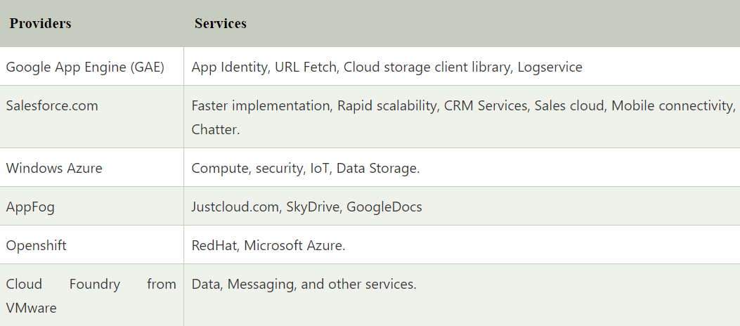
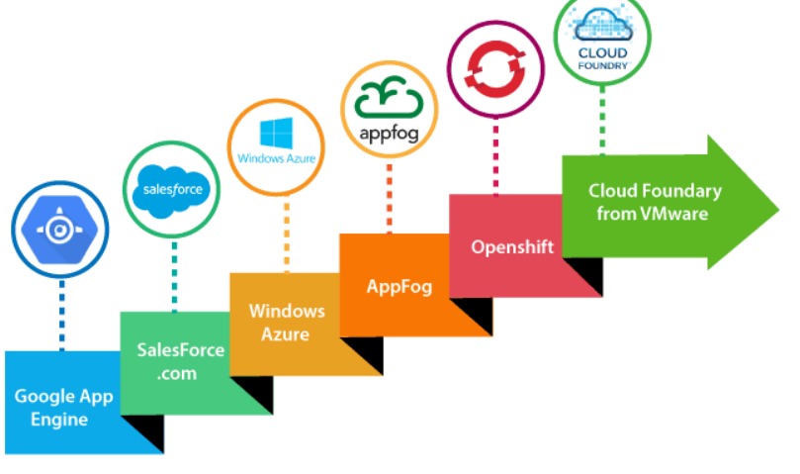
Popular PaaS Provider

Slide 32
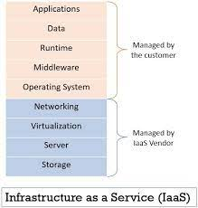
Infrastructure as a Service
Iaas is also known as Hardware as a Service (HaaS). It is one of the layers of the cloud computing platform. It allows customers to outsource their IT infrastructures such as servers, networking, processing, storage, virtual machines, and other resources. Customers access these resources on the Internet using a pay-as-per-use model.
In traditional hosting services, IT infrastructure was rented out for a specific period of time, with pre-determined hardware configuration. The client paid for the configuration and time, regardless of the actual use. With the help of the IaaS cloud computing platform layer, clients can dynamically scale the configuration to meet changing requirements and are billed only for the services actually used.
IaaS cloud computing platform layer eliminates the need for every organization to maintain the IT infrastructure.
IaaS is offered in three models: public, private, and hybrid cloud. The private cloud implies that the infrastructure resides at the customer premise. In the case of public cloud, it is located at the cloud computing platform vendor's data center, and the hybrid cloud is a combination of the two in which the customer selects the best of both public cloud or private cloud.

Slide 33
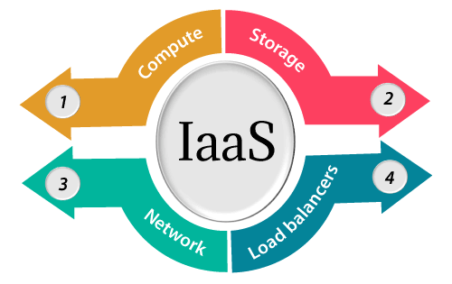
Infrastructure as a Service(Continues)
Compute: Computing as a Service includes virtual central processing units and virtual main memory for the Vms that is provisioned to the end- users.
Storage: IaaS provider provides back-end storage for storing files.
Network: Network as a Service (NaaS) provides networking components such as routers, switches, and bridges for the Vms.
Load balancers: It provides load balancing capability at the infrastructure layer.

Slide 34
Advantages of IaaS cloud computing layer
Shared infrastructure
IaaS allows multiple users to share the same physical infrastructure.
Web access to the resources
Iaas allows IT users to access resources over the internet.
Pay-as-per-use model
IaaS providers provide services based on the pay-as-per-use basis. The users are required to pay for what they have used.
Focus on the core business
IaaS providers focus on the organization's core business rather than on IT infrastructure.
On-demand scalability
On-demand scalability is one of the biggest advantages of IaaS. Using IaaS, users do not worry about to upgrade software and troubleshoot the issues related to hardware components.

Slide 35
Disadvantages of IaaS cloud computing layer
Security
Security is one of the biggest issues in IaaS. Most of the IaaS providers are not able to provide 100% security.
Maintenance & Upgrade
Although IaaS service providers maintain the software, but they do not upgrade the software for some organizations.
Interoperability issues
It is difficult to migrate VM from one IaaS provider to the other, so the customers might face problem related to vendor lock-in.

Slide 36
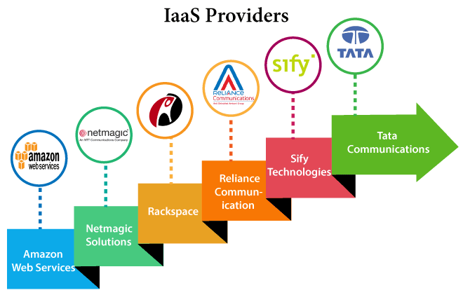
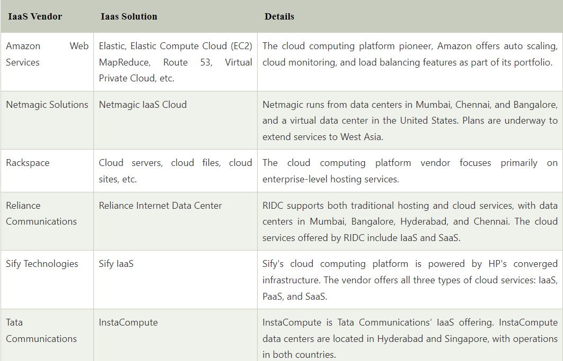
Popular IaaS Provider

Slide 37
THANK YOU

